Slide 1
POSITION ON ACADEMIC PROGRAMMES VIABILITY, ACCOMMODATION, CLASSROOM, ACCREDITATION, EXAMINATION RESULT PROCESSING, CHALLENGES AND WAY FORWARD TO PROPEL EKSU TO WORLD CLASS UNIVERSITY.
BEING A PAPER PRESENTED BY
PROF. ISAAC ABIODUN AJAYI
DEAN OF EDUCATION
AT THE ACADEMIC SUMMIT HELD AT 3000 SEATER LECTURE THEATRE, EKITI STATE UNIVERSITY ON TUESDAY, 2ND—THURSDAY 4TH FEBRUARY, 2016.

Slide 2
INTRODUCTION
FACULTY OF EDUCATION
Date of Establishment:
1983/84 Session.
Main Objective:
To provide qualified teachers at graduate and postgraduate levels who have the mastery of various subjects, combined with a sound academic and professional training in education.
Structure:
There are nine Departments in the Faculty:
1. Department of Adult Education
2. Department of Arts and Language Education
3. Department of Educational Management
4. Department of Guidance and Counselling
5. Department of Human Kinetics and Health Education
6. Department of Science Education
7. Department of Social Science Education
8. Department of Tests, Measurement and Evaluation
9. Department of Vocational and Technical Education

Slide 3
PERSONNEL
Academic Staff (117)
27 Professors
9 Readers
27 Senior Lecturers
54 other Lecturers
Non Academic Staff:
45
Academic Programmes (Senate Approved)
55 undergraduate programmes
1 PGDE programme
15 Masters Degree Programmes
15 Ph.D Degree programmes
Sandwich Programmes
Affiliate Programmes
Students’ Enrolment
Regular programmes
Undergraduate: 4,500
Postgraduate: PGDE=40, M.ED=242, Ph.D = 95 (Total = 377)
Sandwich Programmes: 1,409
Affiliate Programmes: 19,876

Slide 4
Strategic Positions occupied by members
Vice Chancellor
DVC Development
National President EKSU Alumni
Director DCEP
Director Pre Degree
Director Centre for Counselling & Human Development
Director, Distance Learning
Deputy Provost College of Postgraduate Studies
Vice Dean Student Affairs
Assistant Director Affiliate Programmes
Assistant Director Sandwich Programmes

Slide 5
Accommodation
Two Faculty Buildings.
Staff offices
Two large conference rooms.
Faculty Library well equipped with books and journals.
Three Seminar rooms with power point facilities.
Classrooms
The Faculty shares classrooms and large lecture theatres with other faculties.
The classrooms and large lecture theatres are fairly adequate for lectures.
Accreditation
All the academic programmes in the Faculty were accredited except Business Education and the newly approved programmes.
Business Education is long overdue for resource assessment.

Slide 6
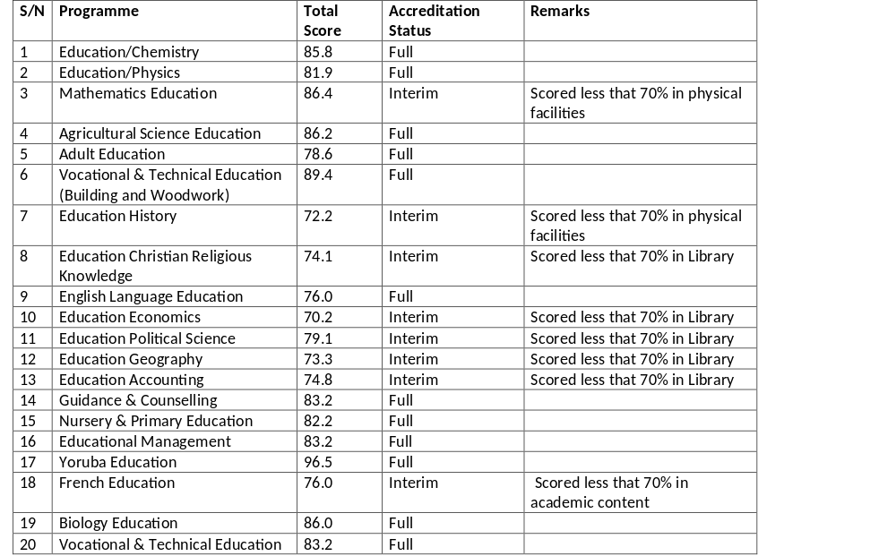
Results of November 2012 Accreditation Exercise.
Summary: Full = 13 Interim = 8.

Slide 7
Accreditation
All the 8 programmes with Interim accreditation were due for accreditation in 2014 but are yet to be visited by NUC.
Other three programmes due for accreditation in 2014 but yet to be visited are Integrated Science Education, Social Studies Education and Human Kinetics and Health Education.
All the 13 programmes with full accreditation are due for accreditation in 2017.
The Faculty has put in place necessary arrangement for the accreditation of these programmes.
The University is yet to procure the facilities requested by the Faculty for the accreditation of some of these programmes.

Slide 8
Examination Result Processing.
Students’ results are processed manually.
Some of the results are delayed because of manual processing and late submission of scores by cognate faculties.

Slide 9
Current Challenges Facing the Faculty
Inadequate office space for staff accommodation
Paucity of funds in the University has made it difficult to commence some newly approved academic programmes.
NUC refusal to approve the commencement of some academic programmes e.g. Educational Management and Guidance and Counselling with Teaching Subjects.
Dwindling enrolment of students
Some academic programmes with very low patronage
Some of the Affiliate programmes are folding up.
Inability of the University to release the Faculty’s share of revenue from the Affiliate programmes.

Slide 10
Current Challenges Facing the Faculty
Lack of ICT facilities for teaching.
Inadequate number of academic staff in some programmes e.g. Social Studies, Early Childhood Education, and Library Science.
Manual computation of results.
Inadequate number of non academic staff in all the Departments.
Inadequate physical facilities in some programmes such as Mathematics, Business Education, Human Kinetics & Health Education and Basic Science.
Inability of postgraduate students to complete their studies at the appropriate time due to:
  Stringent policy of the College of Postgraduate Studies on registration of Thesis Title.
  The tradition of completed Postgraduate thesis waiting for 3 months before it could be sent to External examiners.
  Inadequate funds for international conferences.
  Open ended registration for courses by the students.

Slide 11
Possible Ways of Overcoming the Challenges in order to propel EKSU to World Class University
Provision of additional office space for staff accommodation
The University should provide funds for the commencement of some newly approved academic programmes
Increase in the admission quota of the Faculty.
Introduction of new courses at Masters and Ph.D levels e.g. Business Education, Library and Information Science, Technical Education, Remedial and Reformatory Counselling.
Review of the curricula of academic programmes with very low patronage to make them more attractive
Expansion of the Affiliate programmes
The University should release the Faculty’s share of revenue from the Affiliate programmes.
Provision of ICT facilities for teaching.

Slide 12
Possible Ways of Overcoming the Challenges in order to propel EKSU to World Class University
More academic staff should be recruited in some programmes such as Social Studies, Early Childhood Education and Library Science.
The University management should establish a unit in ICT Directorate for electronic computation of all results to be monitored and verified by each Faculty.
Recruitment of more non academic staff into all the Departments.
Provision of adequate facilities in some programmes such as Mathematics, Business Education, Human Kinetics & Health Education and Basic Science.
Registration of M.Ed Thesis titles should end at the Faculty level while the College of Postgraduate Studies should handle registration of Ph.D thesis titles.
Abolition of the tradition of completed postgraduate thesis waiting for 3 months before it could be sent to external examiners.
More funds should be made available for international conferences.
Effective online registration for courses by students and strict adherence to registration period as stipulated in the academic calendar.

Slide 13
THANK YOU FOR LISTENING

